Slide 1
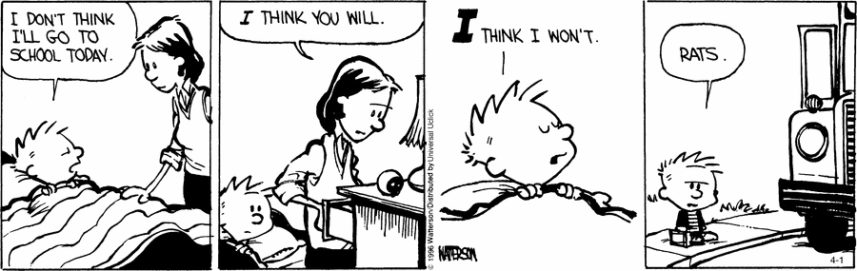

Slide 2

PROCESS COMPONENT ANALYSIS
IMPROVING LINEAR MODEL BY REPLACING LEAST SQUARES ANALYSIS
By: Meera Desai, Abe Melloh, Asef Wafa, Simon Zhang

Slide 3


Slide 4
AGENDA
1.
RECAP WHERE WE CAME FROM
Remember the concepts that we have covered so that we can understand how PCA is relevant.
Goals we will accomplish in this presentation:
2.
LEARN THE THEORY BEHIND PCA/PCR
Understand how the concepts improves accuracy and model interpretability.
3.
PRACTICE A PROBLEM
Perform a lab to make us more familiar on how to use PCR.
Introduction
Recap
Explaining PCA/PCR
Lab
Questions

Slide 5
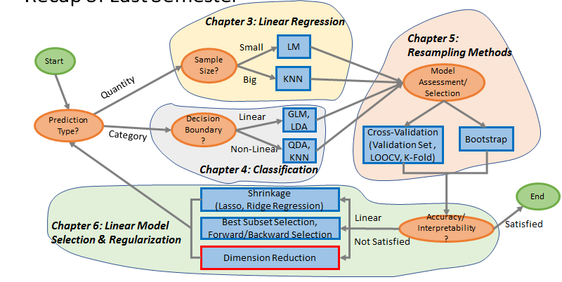
Introduction
Recap
Explaining PCA/PCR
Lab
Questions

Slide 6
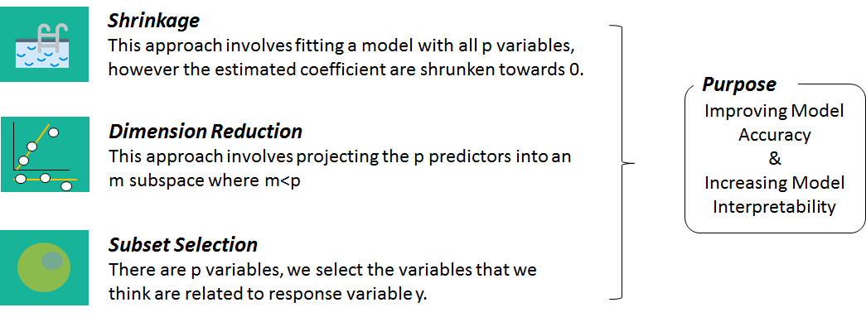
RECAP OF CHAPTER 6
Introduction
Recap
Explaining PCA/PCR
Lab
Questions

Slide 7
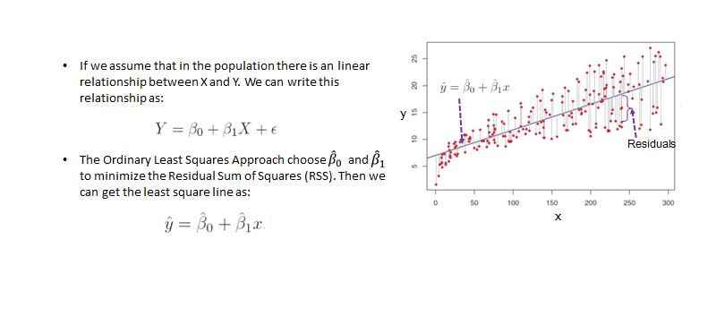
LEAST SQUARES APPROACH
Introduction
Recap
Explaining PCA/PCR
Lab
Questions

Slide 8
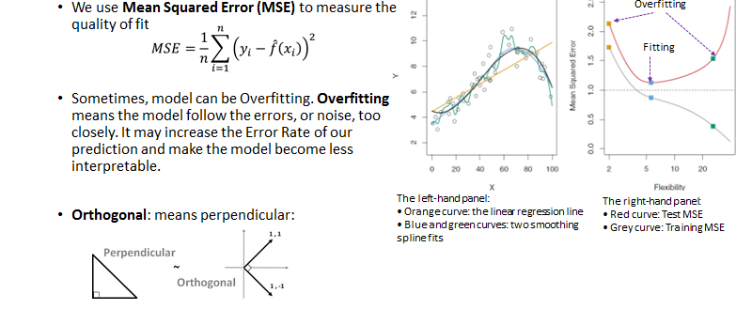
QUALITY OF FIT
Introduction
Recap
Explaining PCA/PCR
Lab
Questions

Slide 9
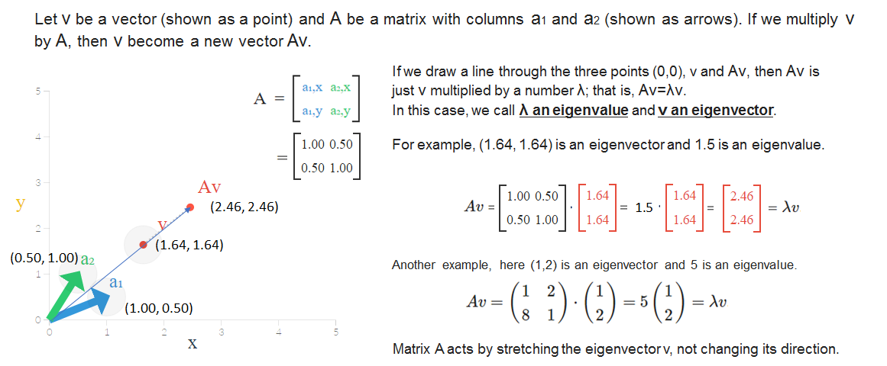
EIGENVECTOR & EIGENVALUES
Introduction
Recap
Explaining PCA/PCR
Lab
Questions

Slide 10
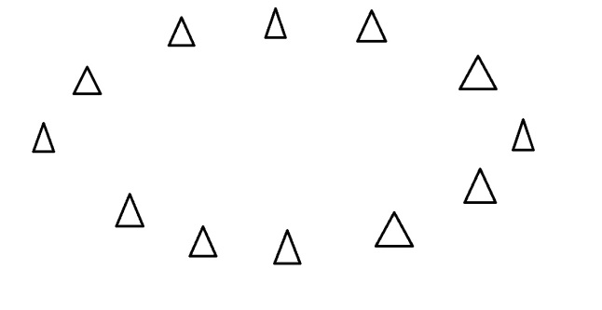
PCA
Introduction
Recap
Explaining PCA/PCR
Lab
Questions

Slide 11
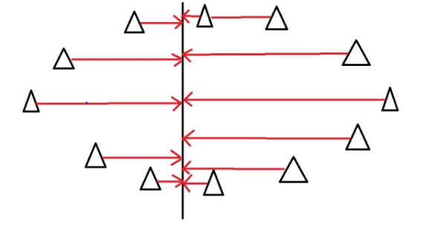
PCA
Introduction
Recap
Explaining PCA/PCR
Lab
Questions

Slide 12
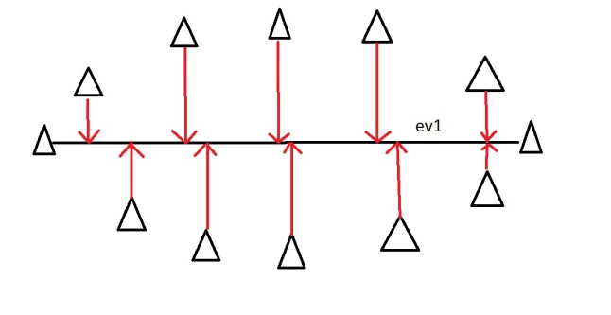
PCA
Introduction
Recap
Explaining PCA/PCR
Lab
Questions

Slide 13
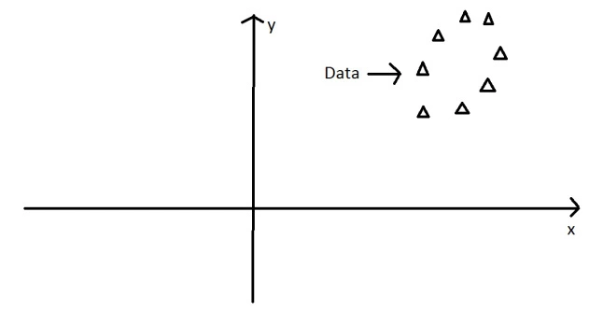
PCA
Introduction
Recap
Explaining PCA/PCR
Lab
Questions

Slide 14
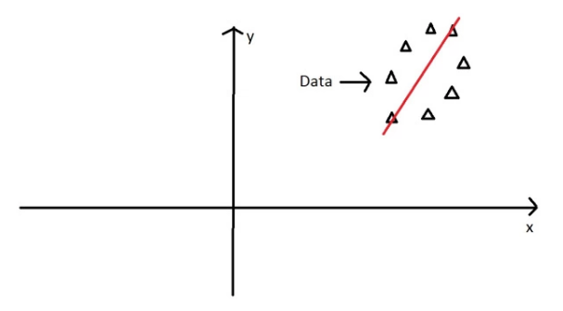
PCA
Introduction
Recap
Explaining PCA/PCR
Lab
Questions

Slide 15
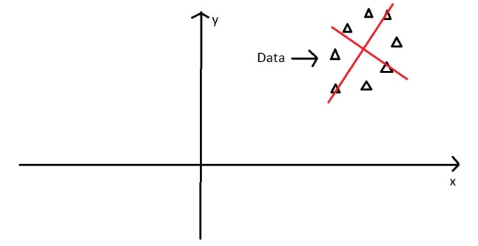
PCA
Introduction
Recap
Explaining PCA/PCR
Lab
Questions

Slide 16
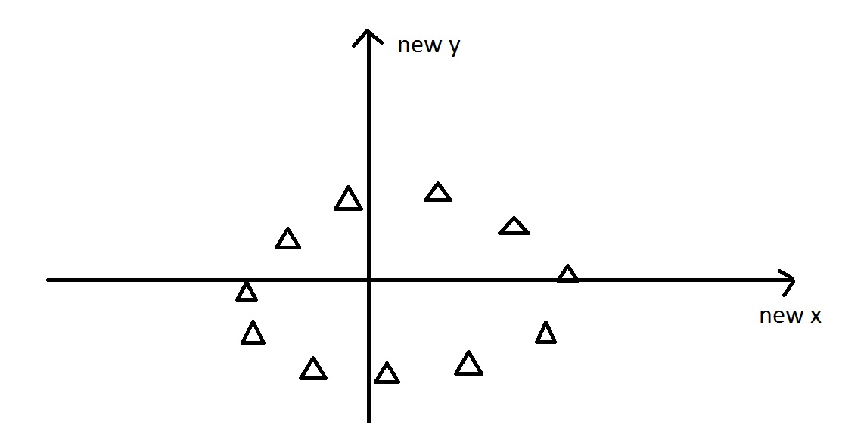
PCA
Introduction
Recap
Explaining PCA/PCR
Lab
Questions

Slide 17

PCA
Introduction
Recap
Explaining PCA/PCR
Lab
Questions

Slide 18
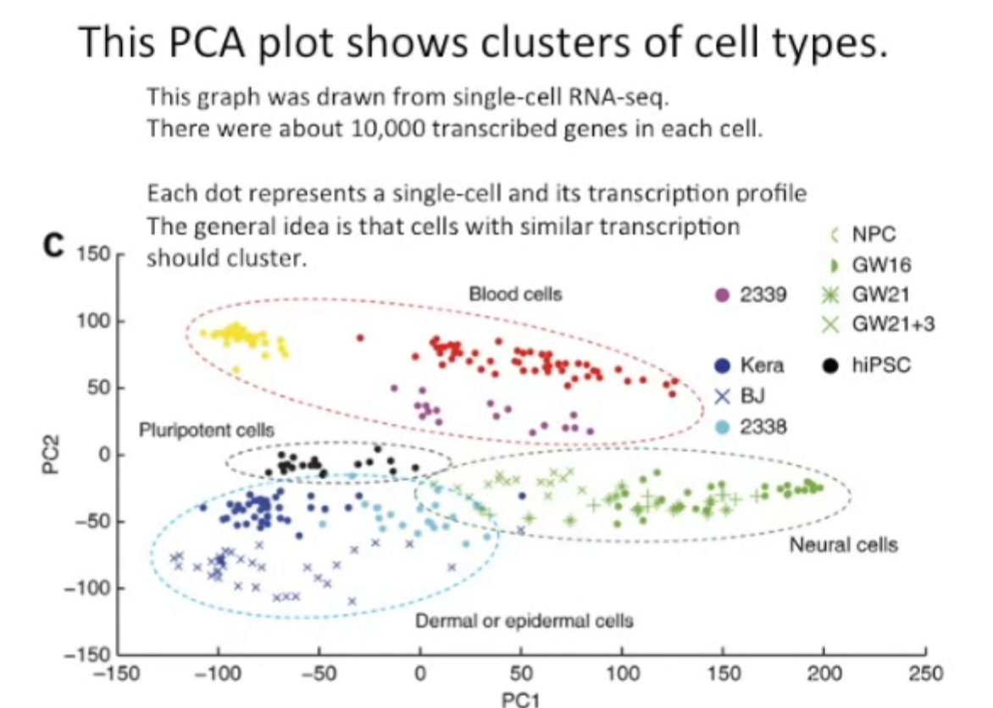
PCA
Introduction
Recap
Explaining PCA/PCR
Lab
Questions

Slide 19
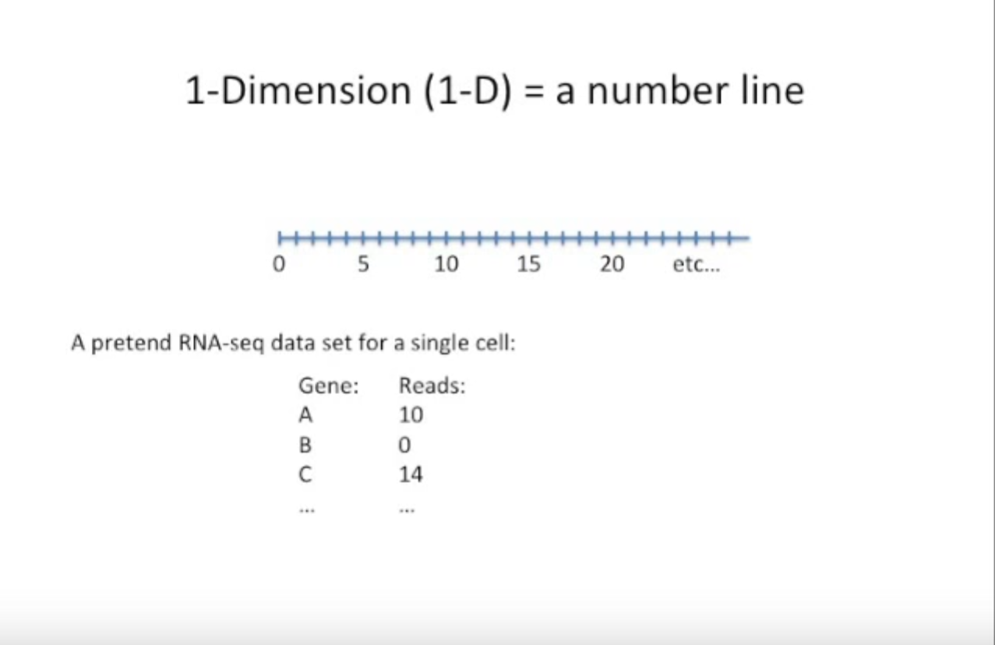
PCA
Cells are the dimensions
The genes are the predictors of those cells
“Reads” are the number of occurrences of a gene in a cell
What type of cell will be produced is the question we are trying to answer. (ie: Cell is our dependent variable)
Introduction
Recap
Explaining PCA/PCR
Lab
Questions

Slide 20
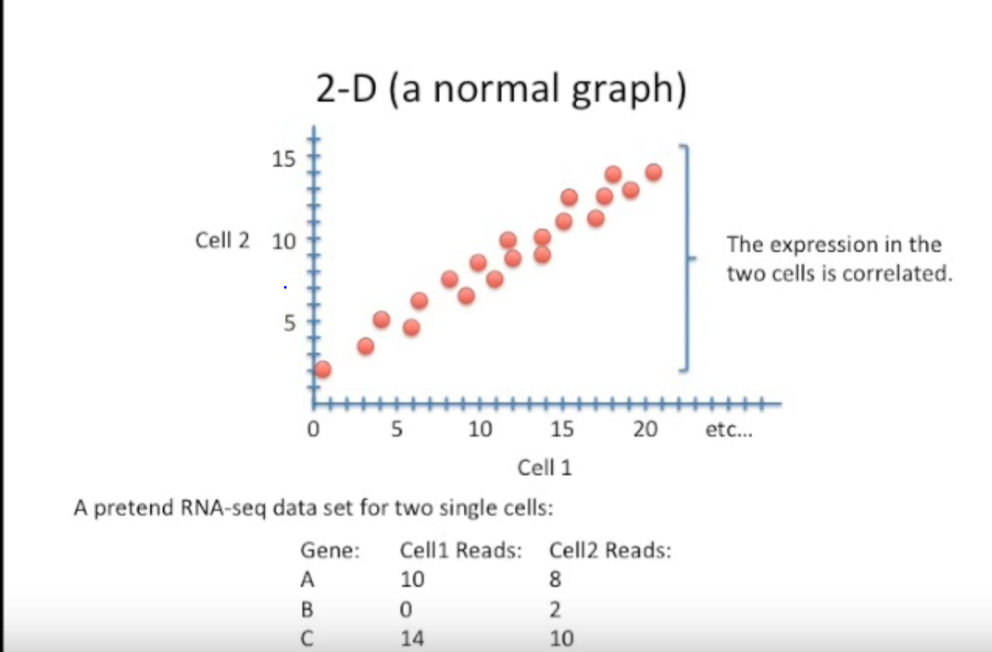
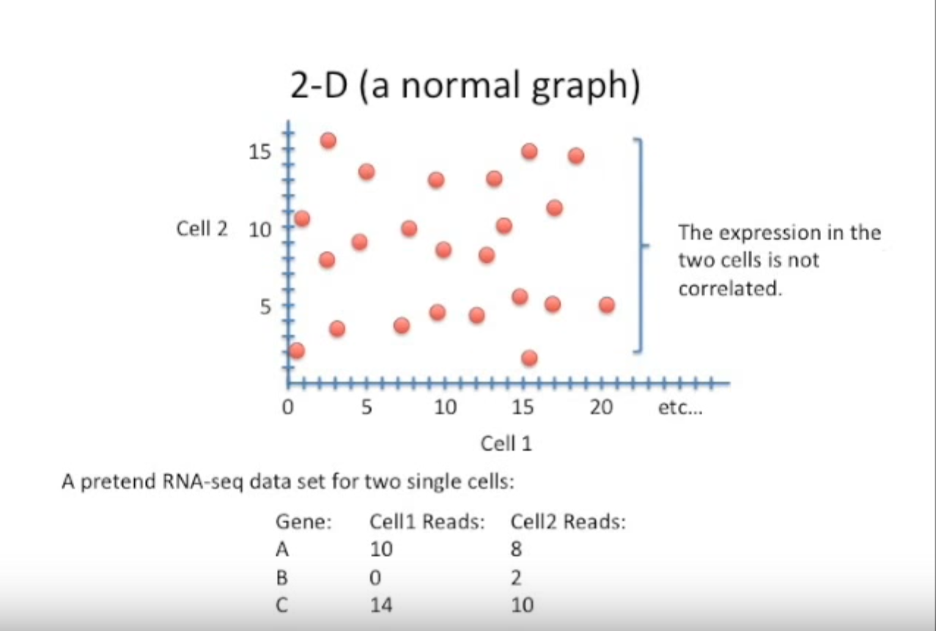
PCA
Introduction
Recap
Explaining PCA/PCR
Lab
Questions

Slide 21
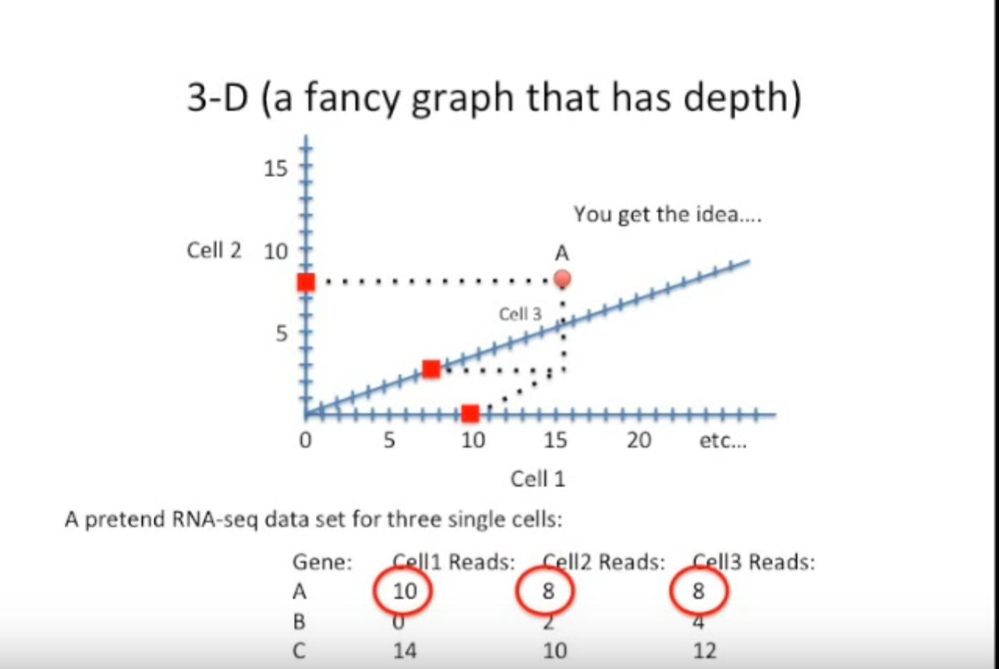
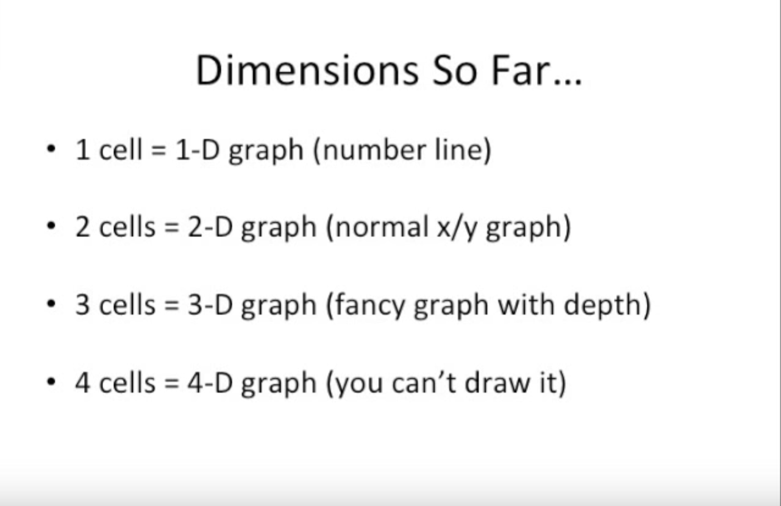
PCA
Introduction
Recap
Explaining PCA/PCR
Lab
Questions

Slide 22
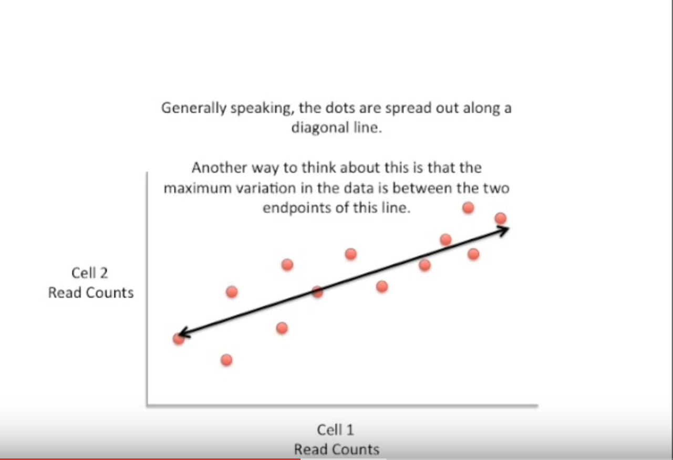
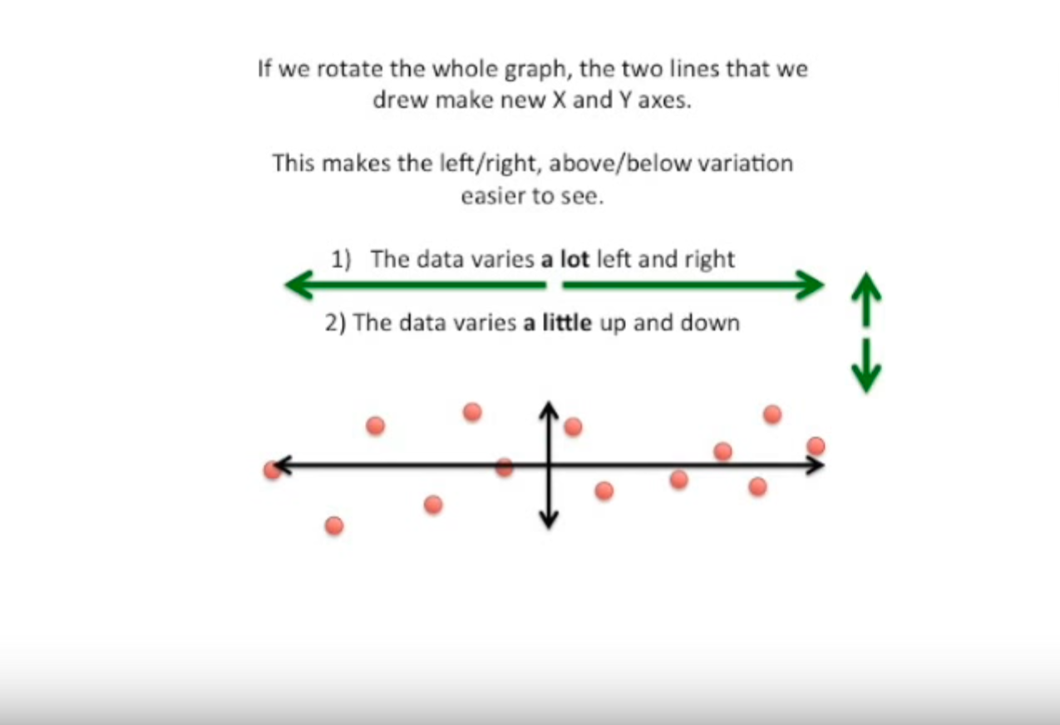
PCA
Introduction
Recap
Explaining PCA/PCR
Lab
Questions

Slide 23
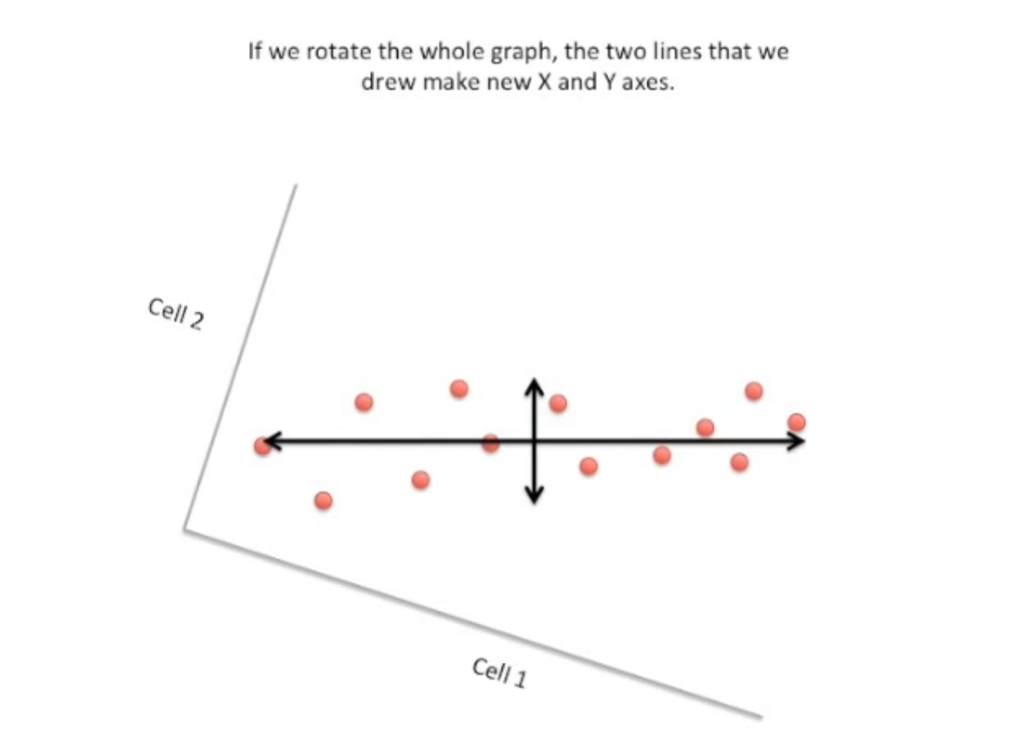
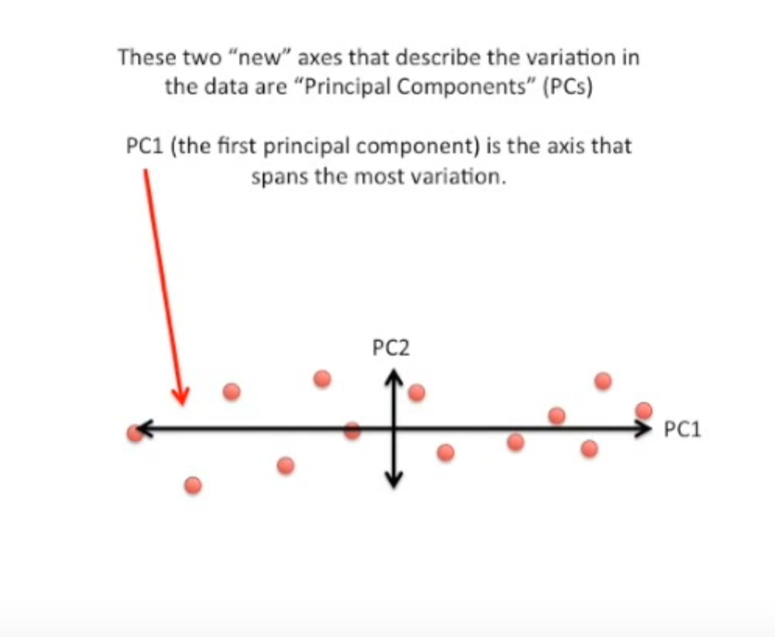
PCA
Introduction
Recap
Explaining PCA/PCR
Lab
Questions

Slide 24
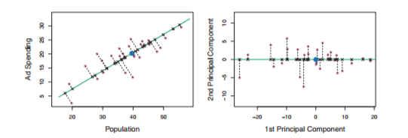
PCA
Introduction
Recap
Explaining PCA/PCR
Lab
Questions

Slide 25
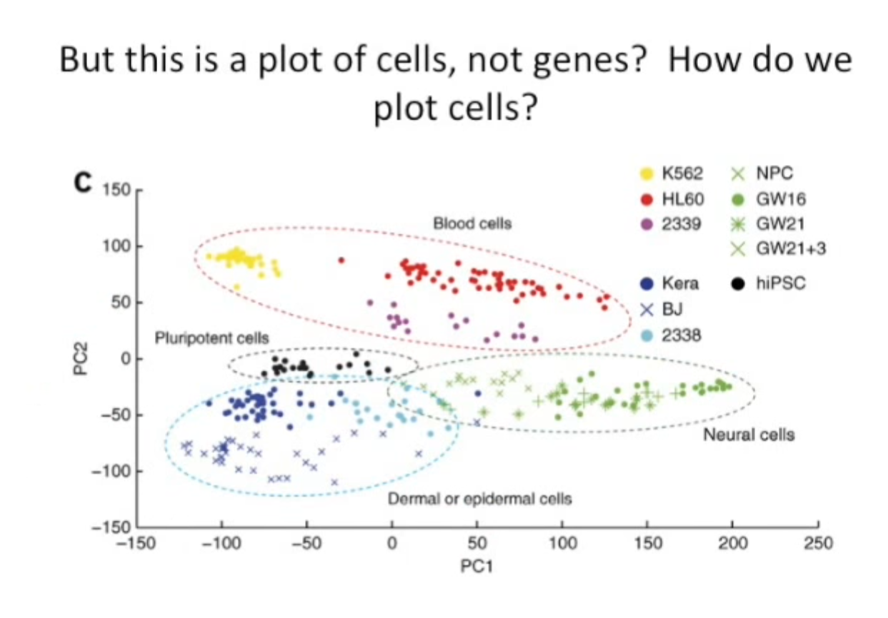
PCA
Introduction
Recap
Explaining PCA/PCR
Lab
Questions

Slide 26
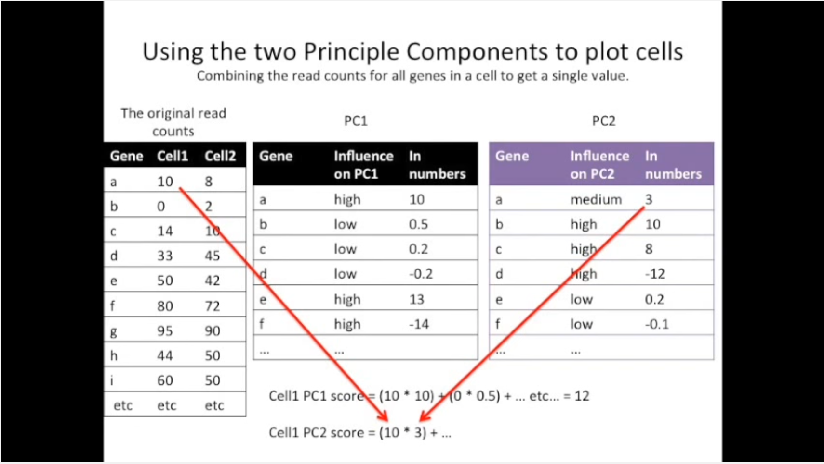
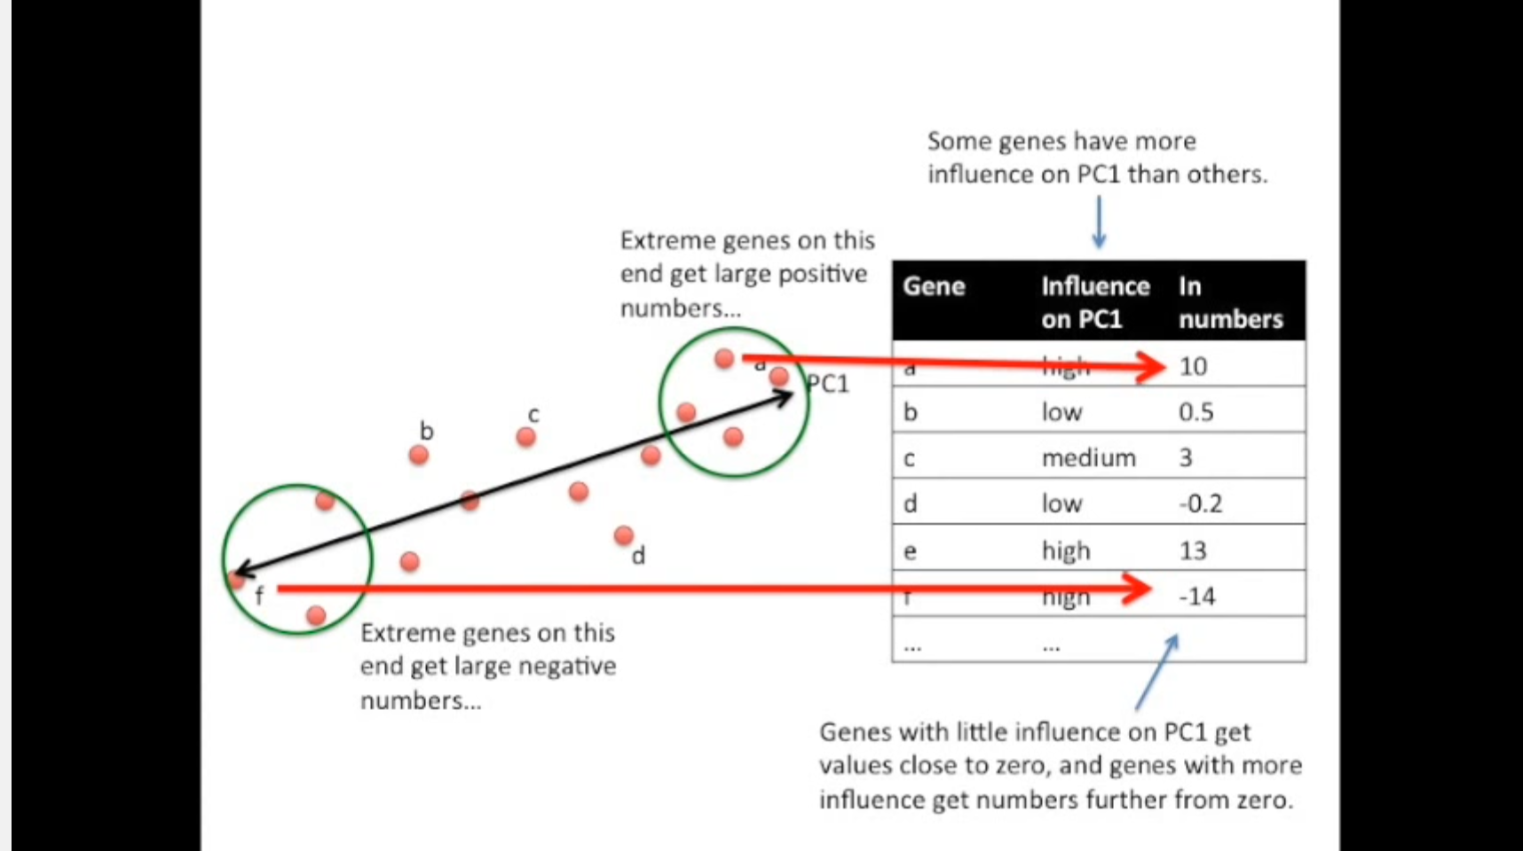
PCA
Introduction
Recap
Explaining PCA/PCR
Lab
Questions

Slide 27
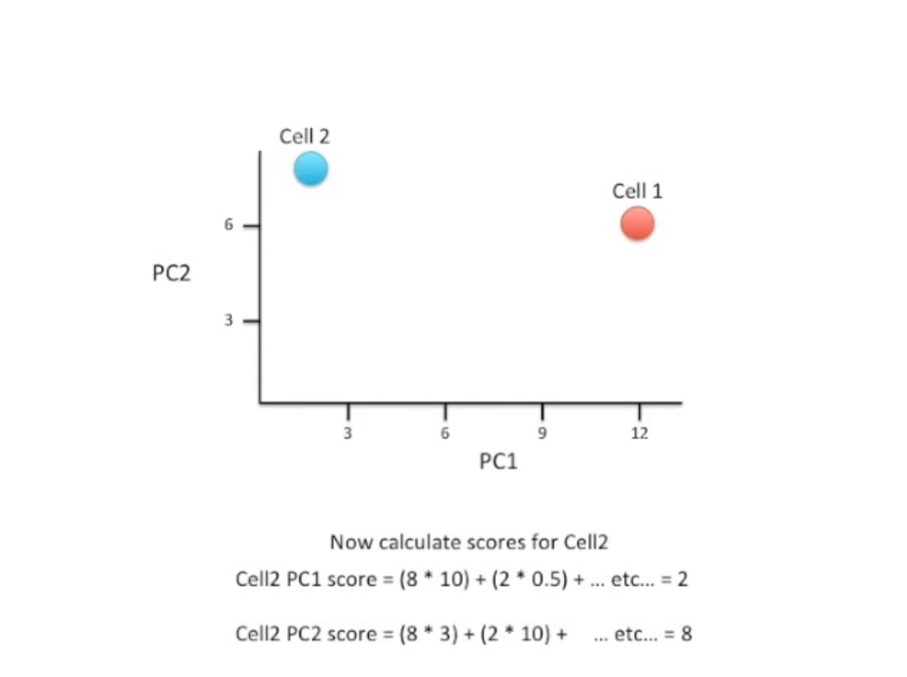
PCA
Introduction
Recap
Explaining PCA/PCR
Lab
Questions

Slide 28
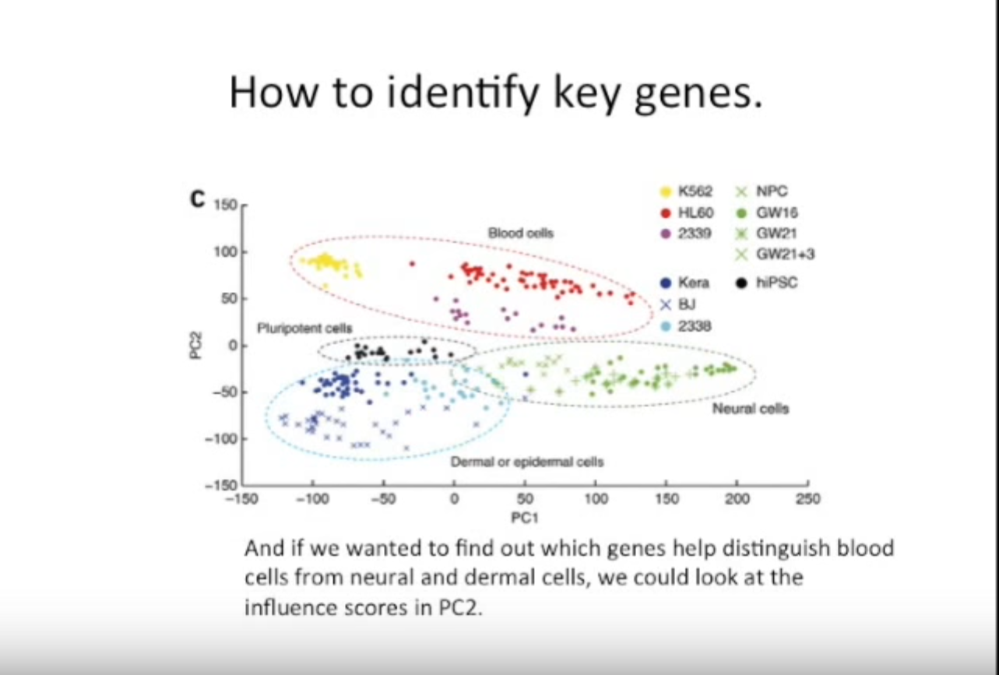
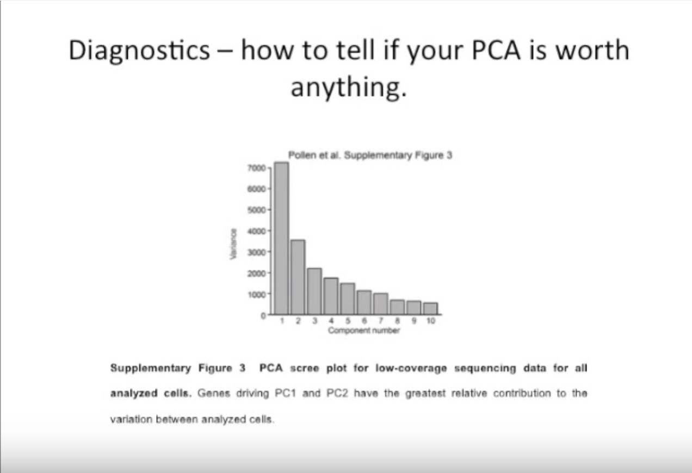
PCA
Introduction
Recap
Explaining PCA/PCR
Lab
Questions

Slide 29
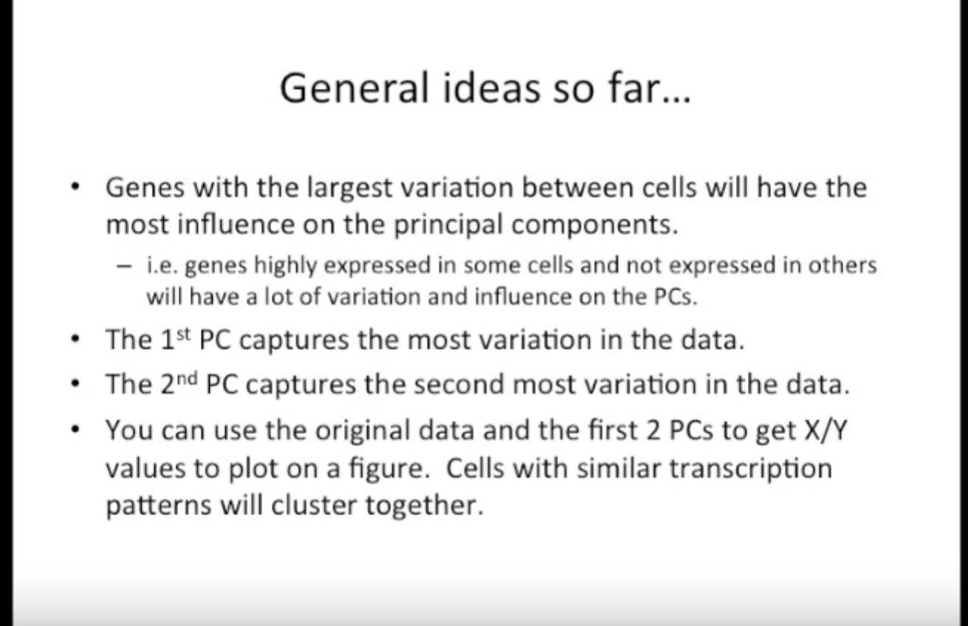
PCA
Introduction
Recap
Explaining PCA/PCR
Lab
Questions

Slide 30
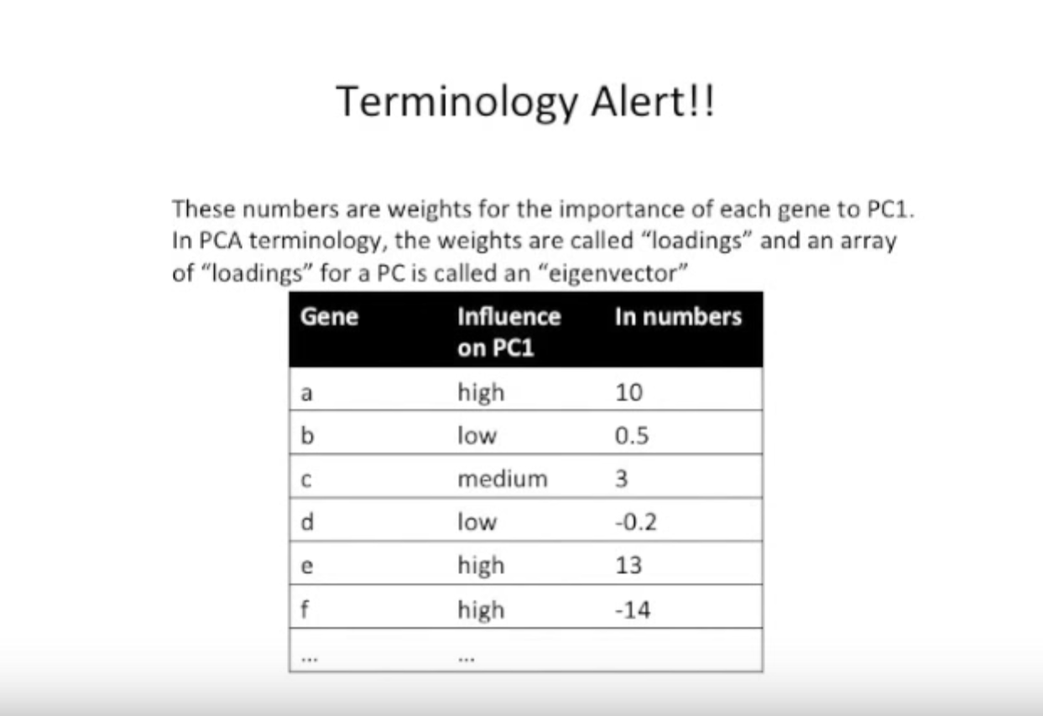
PCA
Introduction
Recap
Explaining PCA/PCR
Lab
Questions

Slide 31
PCR
“In principal components regression (PCR), we use principal components analysis (PCA) to decompose the independent (x) variables into an orthogonal basis (the principal components), and select a subset of those components as the variables to predict y” - (Zumel, 2016)
Introduction
Recap
Explaining PCA/PCR
Lab
Questions

Slide 32
PCR
Data Preparation
Create test and training sets
Cross validation of training set
Check model on the test set
Build model using all the data
STEPS FOR PRINCIPAL COMPONENT REGRESSION
Introduction
Recap
Explaining PCA/PCR
Lab
Questions

Slide 33
PCR
Like PCA, the focus is on the predictors, not the coefficients
Does well when some x’s have a lot of variance, though some x’s with low variance are nonetheless important
Does well when x’s are highly collinear
Bias - Variance tradeoff still applies for components
Use to determine which number of parameters is best
COMPONENTS | BIAS | VARIANCE
+ | - | +
- | + | -
Introduction
Recap
Explaining PCA/PCR
Lab
Questions

Slide 34
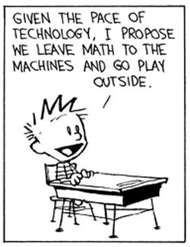
LAB
Use this link to get to the Machine Learning 2 github page:
https://github.com/WilliamandMary-BUAD5082-Spring2017/Class-5-Principal-Component-Analysis
Introduction
Recap
Explaining PCA/PCR
Lab
Questions

Slide 35

ANY QUESTIONS?
Introduction
Recap
Explaining PCA/PCR
Lab
Questions

Slide 36
Sources
Dallas, G. (2015, January 27). Principal Component Analysis 4 Dummies: Eigenvectors, Eigenvalues and Dimension Reduction. Retrieved January 30, 2017, from https://georgemdallas.wordpress.com/2013/10/30/principal-component-analysis-4-dummies-eigenvectors-eigenvalues-and-dimension-reduction/
James, G., Witten, D., Hastie, T., & Tibshirani, R. (2013). An introduction to statistical learning (Vol. 6). New York: springer.
Joshua Starmer. “StatQuest: Principle Component Analysis (PCA) clearly explained.” Online video clip. Youtube. Youtube, 18 Aug 2015. Web. 30 Jan 2016.
Zumel, N. (2016, May 23). Principal Components Regression, Pt.1: The Standard Method. Retrieved January 30, 2017, from http://www.win-vector.com/blog/2016/05/pcr_part1_xonly/
Introduction
Recap
Explaining PCA/PCR
Lab
Questions

